Slide 1
Step 2 Exploring Azure Storage
By Marc Dugas

Slide 2
Goal
We will capture text that is entered in a web form. Next we will encapsulate the text in a message that is then be submitted to an Azure Storage Queue. This way, we can accept an unpredictable amount of messages. Each message then will be processed asynchronously for sentiment analysis.

Slide 3
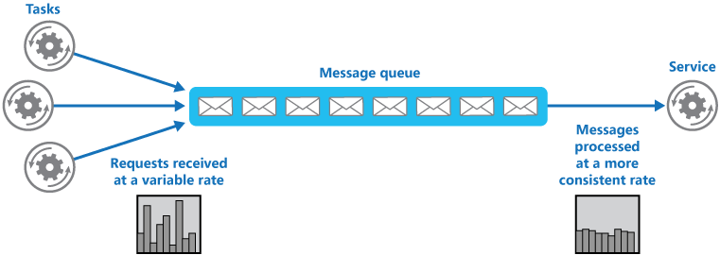
Queue-Based Load Leveling

Slide 4
Azure Storage Services
IaaS
PaaS
Virtual machines
Existing frameworks
Web and mobile
Microservices
Serverless Compute
Storage
Networking
Disks
Persistent disks for Azure IaaS VMs
Unmanaged Disks
Managed Disks
Premium Storage Disks option: SSD based, high IOPS, low latency
Files
Fully Managed File Shares in the Cloud
SMB and REST access
“Lift and shift” legacy apps
Objects
Highly scalable, REST based cloud object store
Block Blobs: Sequential file I/O
Cool Tier Available
Page Blobs: Random-write pattern data
Append Blobs
Tables
Massive auto-scaling NoSQL store
Dynamic scaling based on load
Scale to PBs of table data
Fast key/value lookups
Queues
Reliable queues at scale for cloud services
Decouple and scale components
Message visibility timeout and update message to protect against unreliable dequeuers
Built on a unified Distributed Storage System
Durability, Encryption at Rest, Strongly Consistent Replication, Fault Tolerance, Auto Load-Balancing
Notes:
Azure isn’t about Windows, its about enabling you to achieve more. Microsoft is undergoing a tremendous transformation and Linux/ Open Source Software is part of it. In a second we will dive in and I want you to remember that Microsoft is now the number contributor to OSS on GitHub and that some of the offered services are built and operated on Linux.
One of these services is the Azure SDN (Software Defined Network)
http://www.datacenterdynamics.com/content-tracks/servers-storage/microsoft-runs-azure-networking-on-linux/94837.fullarticle
Azure cloud uses Linux to handle data center networking - in a specialized software component developed by Microsoft to run conectivity within its cloud operating system, along lines set out by the Open Compute Project.

Slide 5
Let’s code!

Slide 6
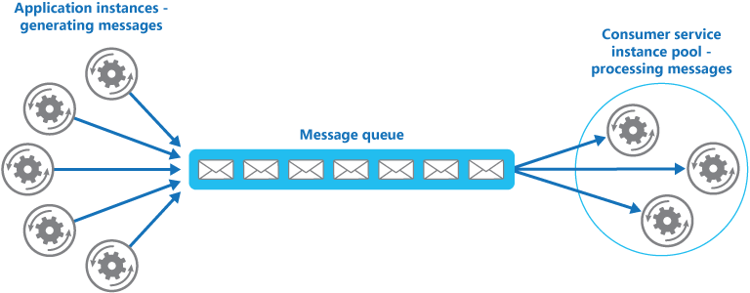
Competing Consumers

Slide 7
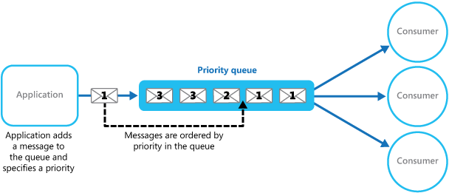
Priority Queue

Slide 8
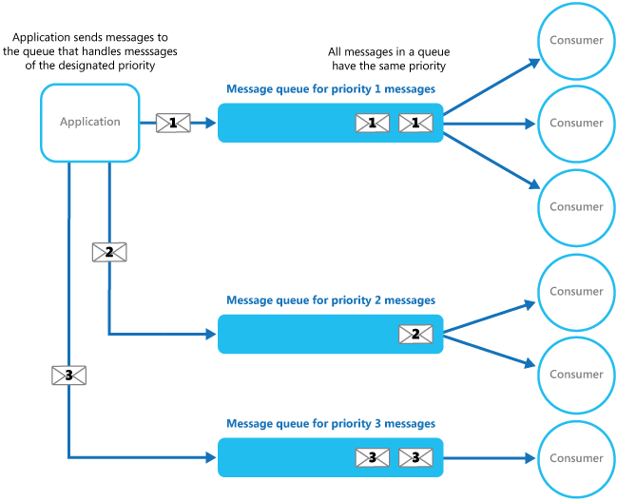
Priority Queue

Slide 9
Q&A

Slide 10
Blob Tiers
Hot – for commonly used data
Cool – for rarely used data
API is 100% identical; similar throughput and latency
Same durability options: LRS, GRS, RA-GRS
Availability:
Cool - 99%
Hot - 99.9%. Higher for RA-GRS reads
Pricing to match your workload
Hot: Lower access prices for frequent use
Cool: Lower storage prices for high volume
Switch account tiers as needed
Blob REST API
Blob Storage Account
Hot Tier
Lower Transaction cost
Blob Storage Account
Cool Tier
Lower Capacity cost
Account level conversion
Notes:
Azure isn’t about Windows, its about enabling you to achieve more. Microsoft is undergoing a tremendous transformation and Linux/ Open Source Software is part of it. In a second we will dive in and I want you to remember that Microsoft is now the number contributor to OSS on GitHub and that some of the offered services are built and operated on Linux.
One of these services is the Azure SDN (Software Defined Network)
http://www.datacenterdynamics.com/content-tracks/servers-storage/microsoft-runs-azure-networking-on-linux/94837.fullarticle
Azure cloud uses Linux to handle data center networking - in a specialized software component developed by Microsoft to run conectivity within its cloud operating system, along lines set out by the Open Compute Project.

Slide 11
Blob Types
Image.jpg
Block Blobs
Most object storage scenarios
Documents, images, video, etc.
Append Blobs
Multi-writer append only scenarios
Logging, Big Data Analytics output
Page Blobs
Page aligned random reads and writes
IaaS Disks, Event Hub, Block level backup
Block 1
Block 2
Block 3
Block 4
Block 1
Block 2
Block 3
Block 4
512
1024
1536
2048
Sparse File
512 byte aligned
2560
Notes:
Azure isn’t about Windows, its about enabling you to achieve more. Microsoft is undergoing a tremendous transformation and Linux/ Open Source Software is part of it. In a second we will dive in and I want you to remember that Microsoft is now the number contributor to OSS on GitHub and that some of the offered services are built and operated on Linux.
One of these services is the Azure SDN (Software Defined Network)
http://www.datacenterdynamics.com/content-tracks/servers-storage/microsoft-runs-azure-networking-on-linux/94837.fullarticle
Azure cloud uses Linux to handle data center networking - in a specialized software component developed by Microsoft to run conectivity within its cloud operating system, along lines set out by the Open Compute Project.

Slide 12
Create Azure Storage Account : Portal
Sign in to the Azure portal.
On the Hub menu, select New -> Storage -> Storage account.
Enter a name for your storage account. (the storage account name will be used to address your objects in Azure Storage)
Select the type of storage account: General purpose
Specify the performance tier: Standard
Select the replication option for the storage account: LRS
Select the subscription in which you want to create the new storage account.
Specify a new resource group or select an existing resource group.
Select the geographic location for your storage account.
Click Create to create the storage account.
docs.microsoft.com/en-us/azure/storage/storage-create-storage-account

Slide 13
Create Azure Storage Account: CLI 2.0
az login
az account list
az account set --subscription ‘MSDN MVP’
az group create --name demo --location canadaeast
az storage account create --resource-group demo --location canadaeast --name gabdemosa --sku Standard_LRS --kind Storage
az storage account show-connection-string --resource-group demo --name gabdemosa

